Slide 1
A Greedy Dog

Slide 2

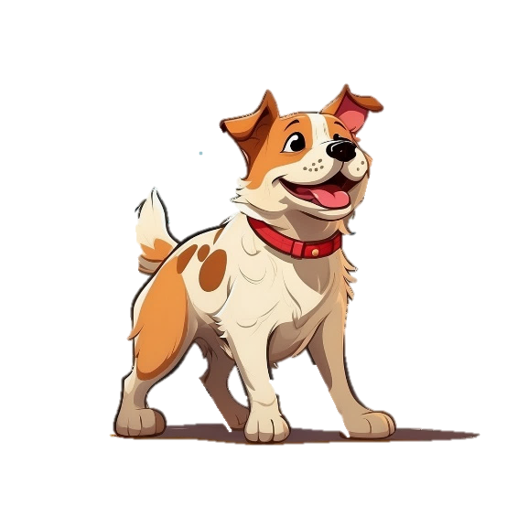
Oh ! no.
I am hungry!!!
Now , I should search something to eat.

Slide 3


Oh! I found a bone.

Slide 4

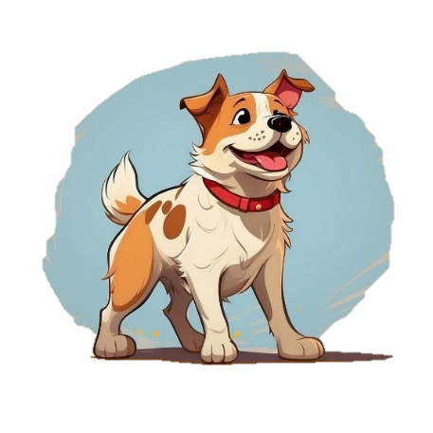
Oh! I found a new bone

Slide 5

Bark!

Slide 6
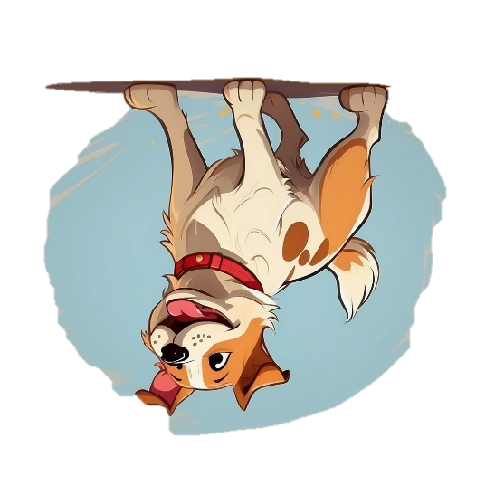
Oh! I lost everything

Slide 7
Moral:
Greed is the curse.

